Slide 1





INTERNIFY
Internship Management System
Internship management system facilitates efficient coordination.
Presentation by: Jitali Patel (225160694023)
Manasvi Patel (225160694025)

Slide 2





WHAT WE WILL TALK ABOUT
Introduction
Requirement Analysis
System Design
Development
Conclusion
Future Enhancement

Slide 3
INTRODUCTION
Existing System
Objective of New System
Core Component
Project Profile
Advantages & Limitations

Slide 4

INTRODUCTION
Internship Management System is designed to assist you in developing the most effective program, offering internships to students.
An internship is a first opportunity to get to know an industry, a job role and the working culture of a company, whereas making contacts and applying skills developed during university.

Slide 5
1. EXISITING SYSTEM
The existing internship management system, if any, likely involves manual processes such as handling paperwork, sending emails, and maintaining spreadsheets or databases to track internships.
This system might lack integration, leading to inefficiencies and challenges in managing internships effectively.

Slide 6
2. OBJECTIVE OF NEW SYSTEM
Automating administrative tasks such as internship posting, application management, and progress tracking.
Improving communication channels between interns, mentors, administrators, and employers.
Enhancing the matching process by implementing algorithms that consider the skills, interests, and preferences of both interns and employers.

Slide 7
3. CORE COMPONENTS
Actor | Definition
Admin | Manages system settings, users accounts, and oversees the overall operations of the system.
Student | Seeks internship opportunities, applies for internships, communication with mentors and administrators, and tracks internship progress.
Faculty | Guides and evaluates interns, communicates with intern and administrators, and monitors intern progress.
Company | Posts internship opportunities, reviews applications, communicates with interns and administrators, and manages internship details.
Admin
Student
Company
Faculty

Slide 8
4. PROJECT PROFILE
Project Definition | Internship Management System
Team Id | G16
Team Details | Patel Jitali (225160694023) Patel Manasvi (225160964025)
Mentor Detail | Prof: Jaimin Chawda

Slide 9
5. ADVANTAGES & LIMITATIONS
ADVANTAGES | LIMITATIONS
Streamlines processes Reducing manual tasks Saving time Facilitates seamless communication | Can lead to inefficient data transfer Systems require regular updates Regularly bug fixing a maintenance

Slide 10
REQURIMENT DETERMINATAION
AND ANALYSIS
Requirement Determination
Targeted Users

Slide 11
1. REQUIREMENT DETERMINATION
Identifying the specific requirements of interns, faculties, company and admin.
Gathering input from all stakeholders to understand their expectations
Focusing on usability and user interface design
Defining the desired features and functionalities of the system
Analyze the gathered requirements to ensure they are clear, complete, and consistent.

Slide 12
2. TARGETED USERS
ADMIN
Manage Student
STUDENT
Apply For NOC
FACULTY
COMPANY
Manage Faculty
Manage Projects
Assign Guide
Apply For Internship
View Score
Update Profile
View NOC Applications
View Project Details
Give Score
Add Vacancies
View Internship Applications Approval/Reject
Assign Project

Slide 13
SYSTEM DESIGN
Use case Diagram
Class Diagram
Interaction Diagram
Activity Diagram
Data Dictionary

Slide 14
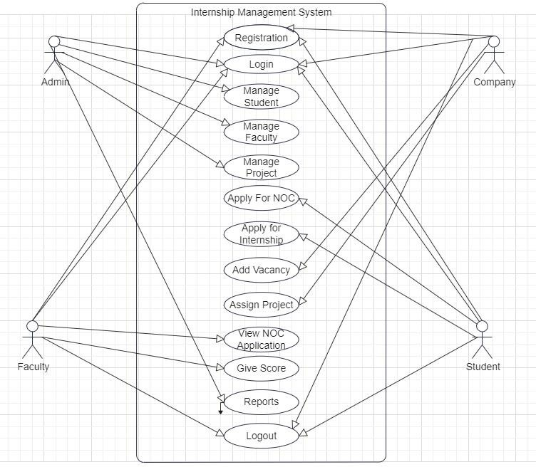
1. USE CASE DIAGRAM

Slide 15
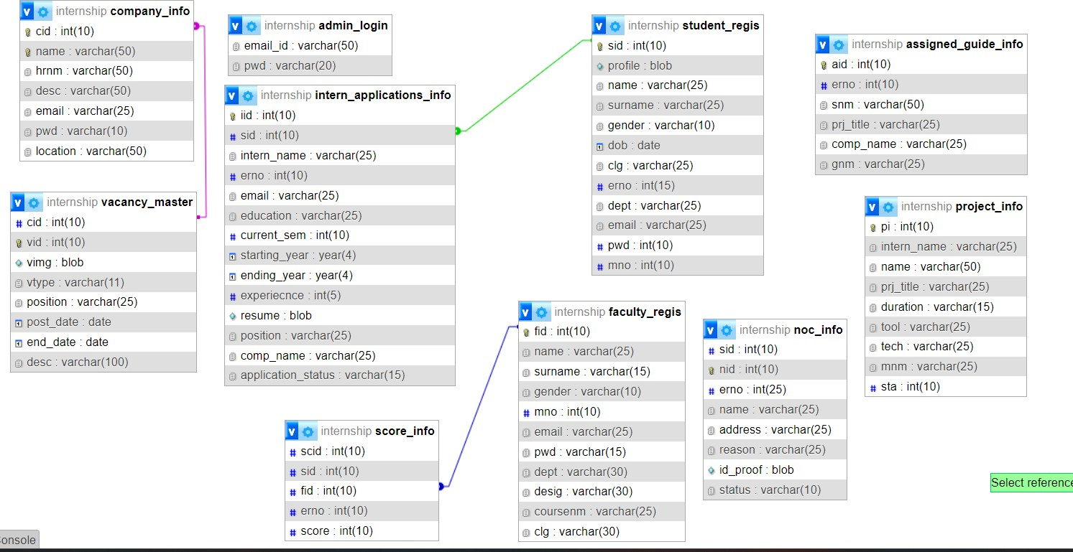
2. CLASS DIAGRAM

Slide 16
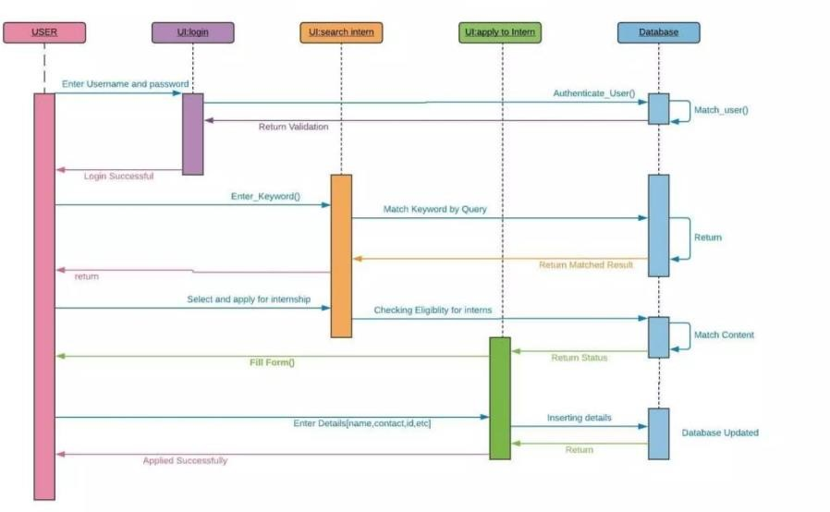
3. INTERACTION DIAGRAM

Slide 17
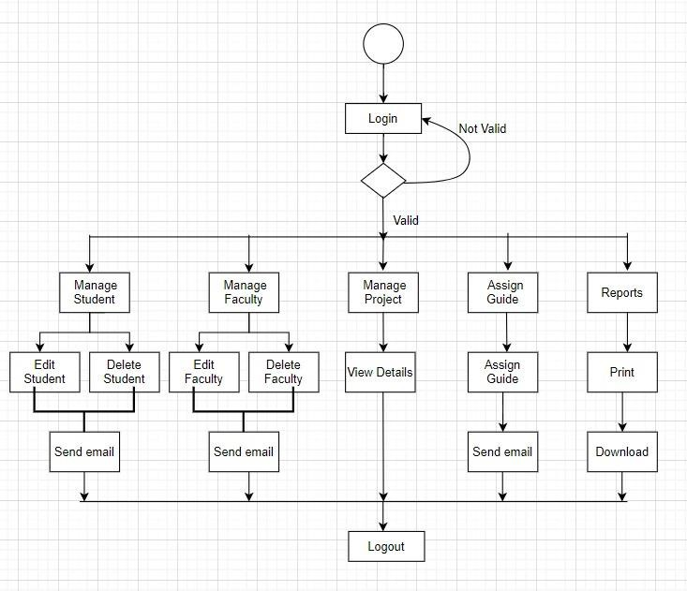
4. ACTIVITY DIAGRAM: ADMIN

Slide 18
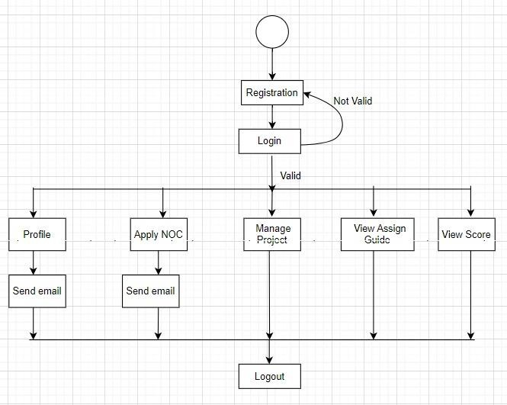
5.ACTIVITY DIAGRAM:STUDENT

Slide 19
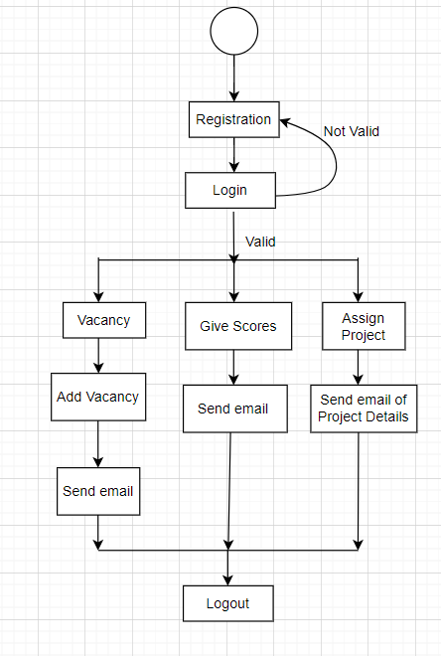
6.ACTIVITY DIAGRAM: COMPANY

Slide 20
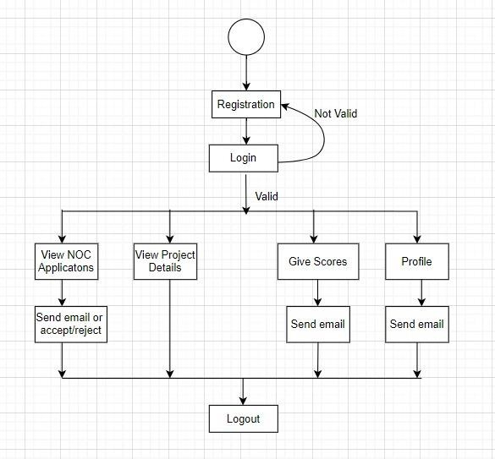
7.ACTIVITY DIAGRAM:FACULTY

Slide 21
5. DATA DICTIONARY
ADMIN_LOGIN
Column | Type | Null
email_id | varchar(50) | No
pwd | varchar(20) | No
ASSIGNED_GUIDE_INFO
Column | Type | Null
aid (Primary) | int(10) | No
erno | int(10) | No
snm | varchar(50) | No
prj_title | varchar(25) | No
comp_name | varchar(25) | No
gnm | varchar(25) | No

Slide 22
COMPANY_INFO
Column | Type | Null
cid (Primary) | int(10) | No
name | int(10) | No
hrnm | varchar(50) | No
email | varchar(25) | No
pwd | varchar(25) | No
location | varchar(25) | No

Slide 23
FACULTY_REGIS
Column | Type | Null
fid (Primary) | int(10) | No
name | int(10) | No
surname | varchar(50) | No
gender | varchar(25) | No
mno | varchar(25) | No
email | varchar(25) | No
pwd | varchar(15) | No
dept | varchar(30) | No
desig | varchar(30) | No
coursenm | varchar(25) | No
clg | varchar(30) | No

Slide 24
NOC_APPLICATIONS_INFO
Column | Type | Null | Default
sid | int(10) | No
nid (Primary) | int(10) | No
erno | varchar(50) | No
name | varchar(25) | No
address | varchar(25) | No
reason | varchar(25) | No
id_proof | varchar(15) | No
status | varchar(30) | No | Pending

Slide 25
INTERN_APPLICATIONS_INFO
Column | Type | Null | Default
iid (Primary) | int(10) | No
sid | int(10) | No
intern_name | varchar(25) | No
erno | int(10) | No
email | varchar(25) | No
current_sem | int(10) | No
starting_year | year(4) | No
ending_year | year(4) | No
experiecnce | int(5) | No
resume | Blob | No
position | varchar(25) | No
comp_name | varchar(25) | No
status | varchar(30) | No | Pending

Slide 26
PROJECT_INFO
Column | Type | Null
pi (Primary) | int(10) | No
intern_name | varchar(25) | No
name | varchar(50) | No
prj_title | varchar(25) | No
Duration | varchar(15) | No
tool | varchar(25) | No
tech | varchar(25) | No
mnm | varchar(25) | No
sta | Int(10) | No

Slide 27
SCORE_INFO
Column | Type | Null
scid | int(10) | No
sid | int(10) | No
fid | int(10) | No
erno | int(10) | No

Slide 28
STUDENT_REGIS
Column | Type | Null
sid (Primary) | int(10) | No
profile | Blob | No
name | varchar(25) | No
surname | varchar(25) | No
gender | varchar(10) | No
dob | date | No
clg | varchar(25) | No
erno | int(15) | No
dept | varchar(25) | No
email | varchar(25) | No
pwd | int(10) | No
mno | int(10) | No

Slide 29
VACANCY_MASTER
Column | Type | Null
vid (Primary) | int(10) | No
cid | int(10) | No
vimg | Blob | No
vtype | varchar(25) | No
position | varchar(10) | No
Post_date | date | No
end_date | date | No
desc | int(100) | No

Slide 30
DEVELOPMENT
Coding Standards
Screenshots

Slide 31
1. CODING STANDARDS
Coding standards are often specific to a programming language, project, or organization.
Naming convention
Formatting and Indentation
Comments and Documentations
Code and Structure and Organization
Error Handling and Exception Management
Code Reusability and Modularity
Testing and Quality Assurance
Version control and Collaboration

Slide 32

2. SCREENSHOTS
HOME PAGE

Slide 33
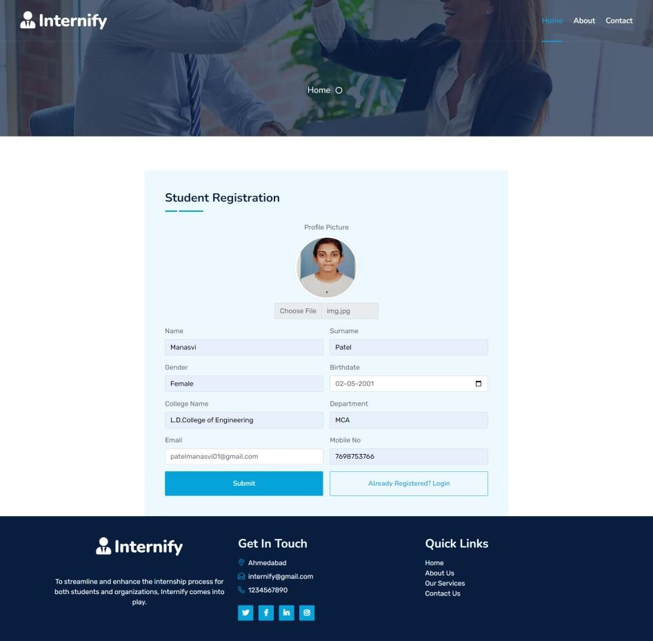
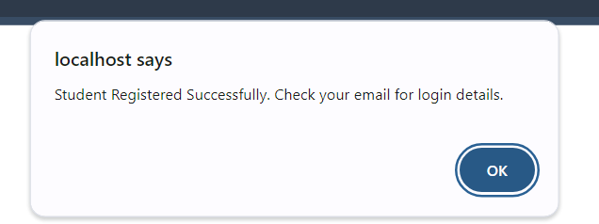
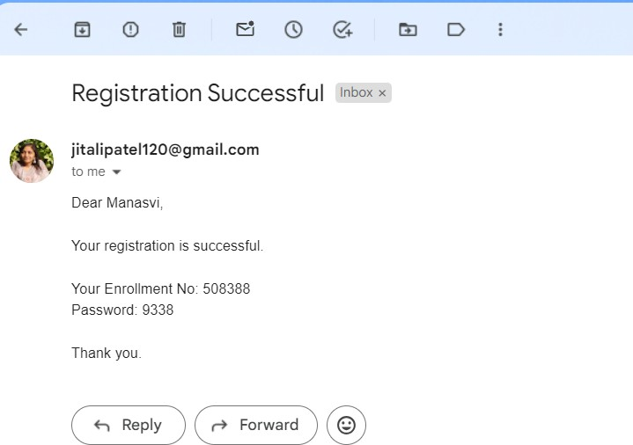
STUDENT REGISTRATION

Slide 34
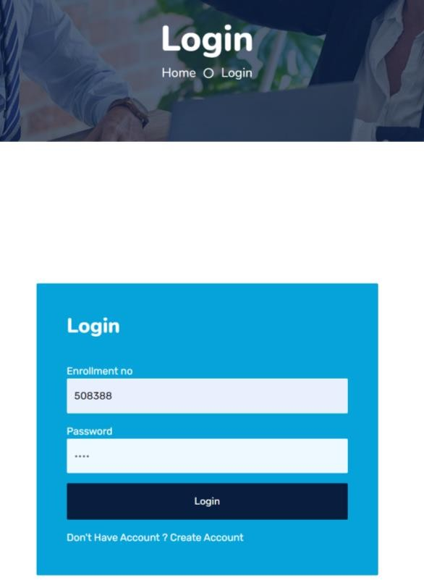
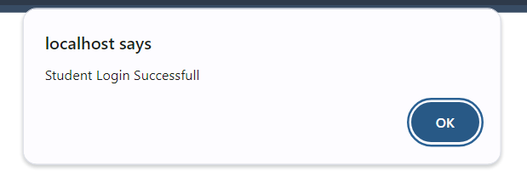
STUDENT LOGIN

Slide 35
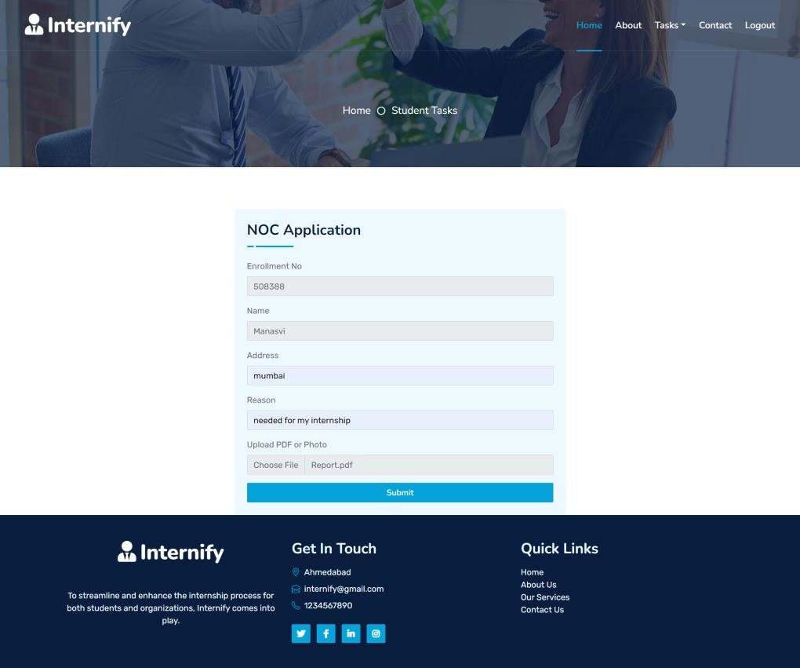
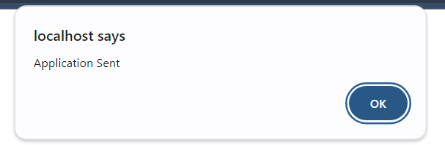
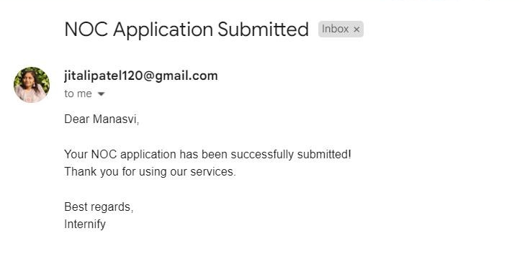
NOC APPLICATION

Slide 36

VIEW VACANCY

Slide 37
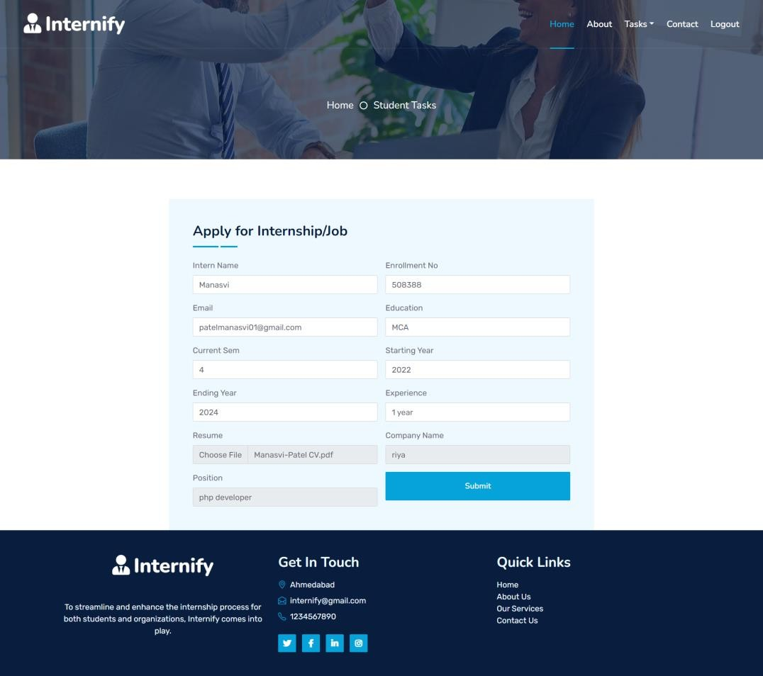
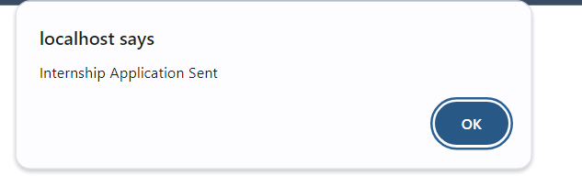
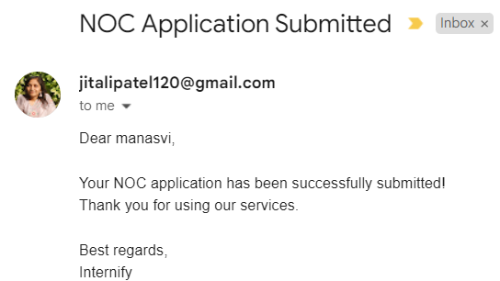
APPLY INTERNSHIP

Slide 38

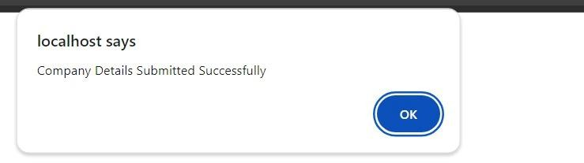
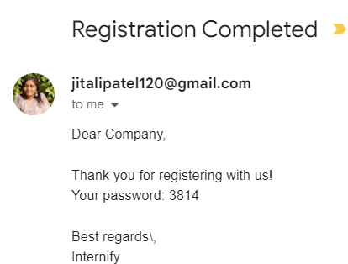
COMPANY REGISTRATION

Slide 39
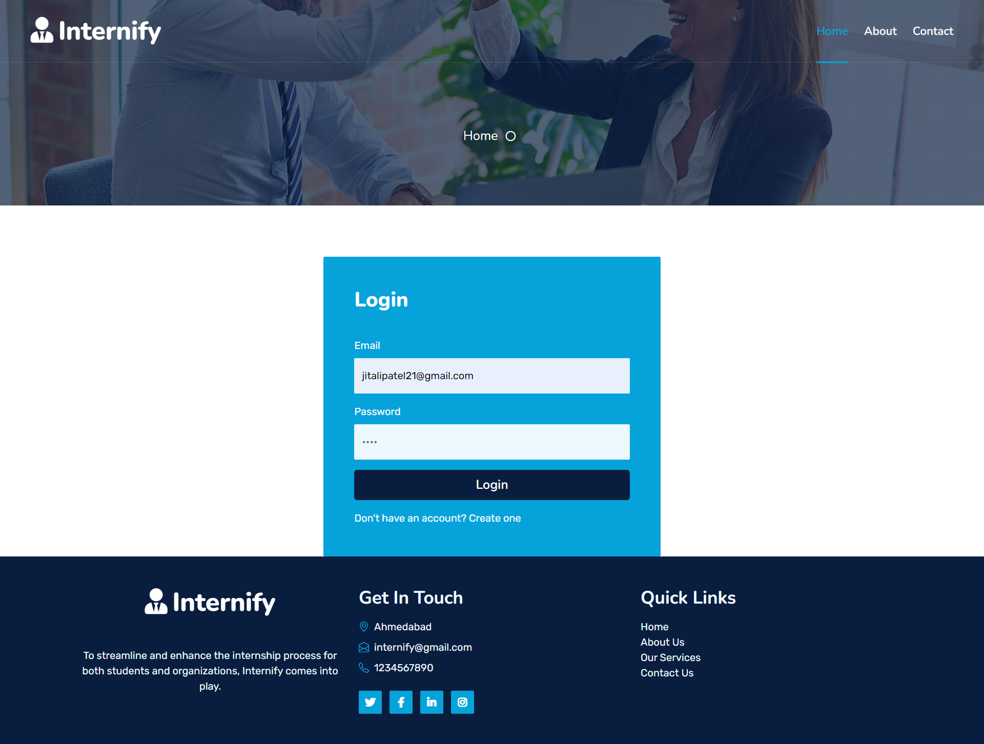
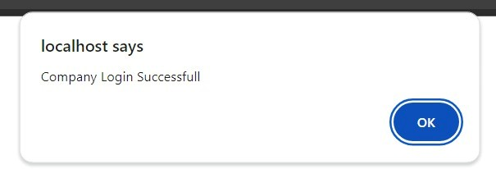
COMPANY LOGIN

Slide 40
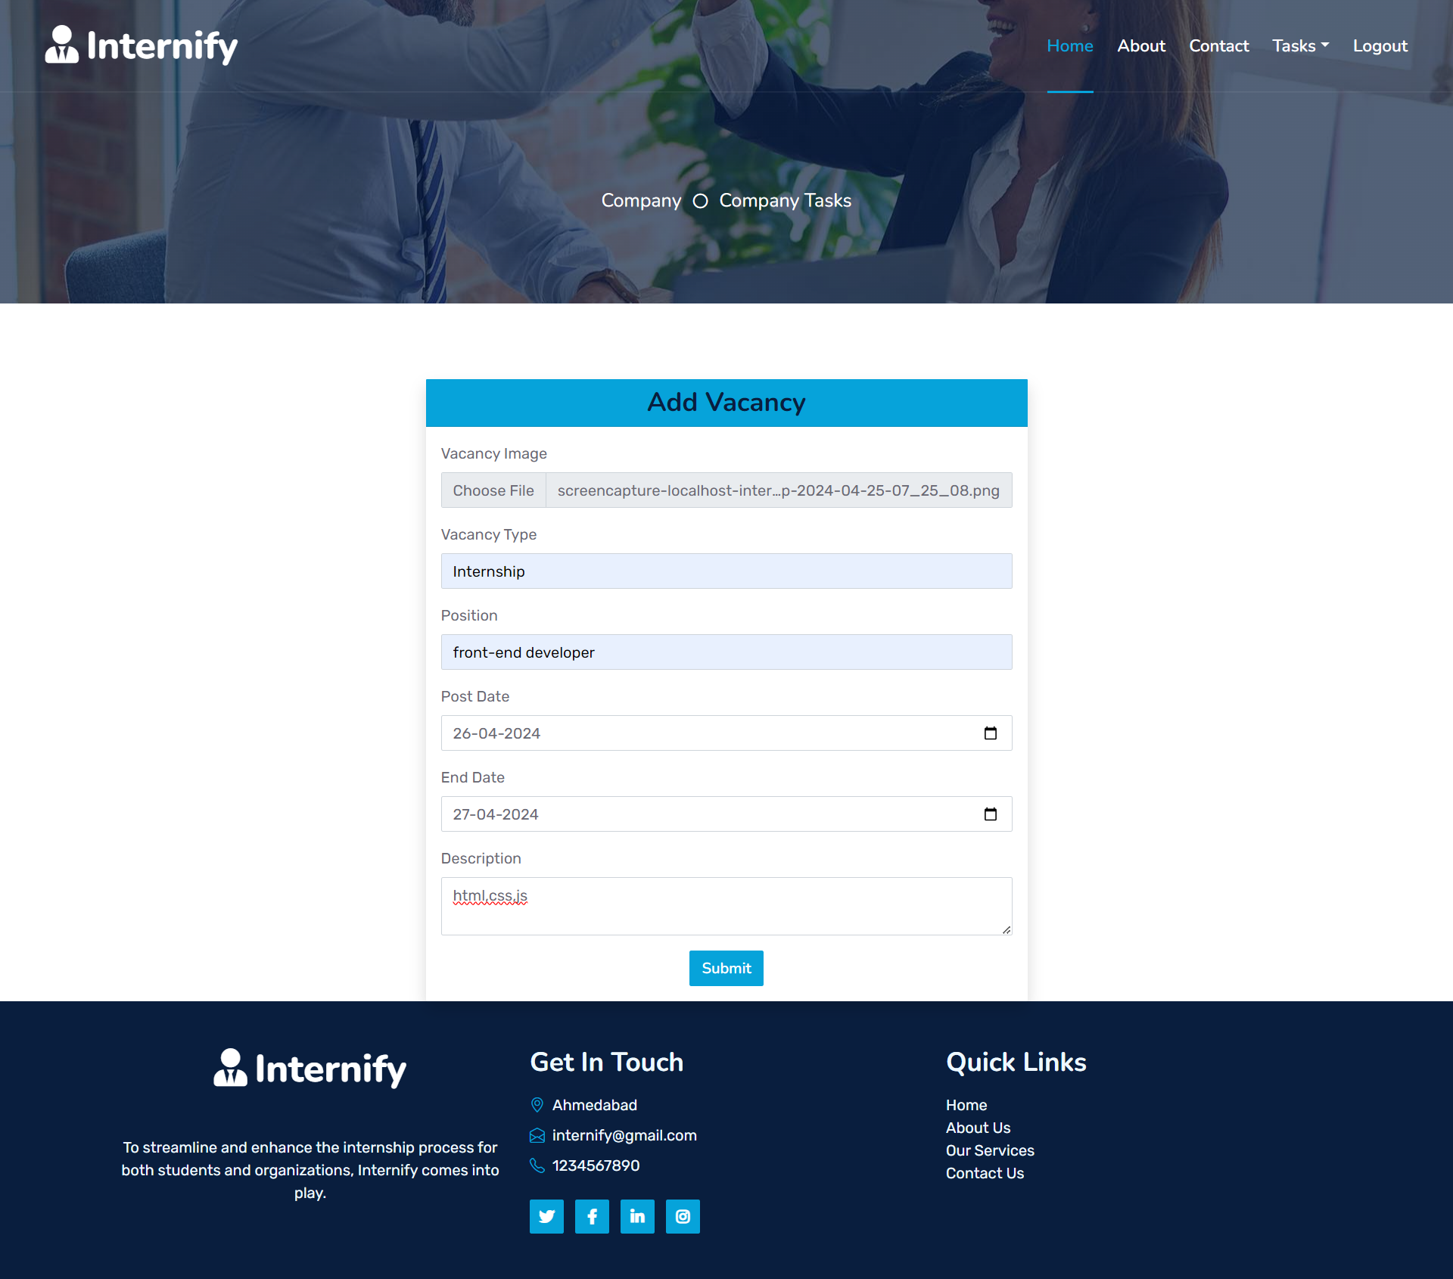
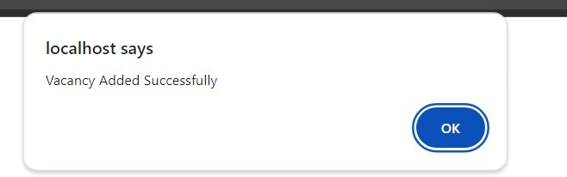
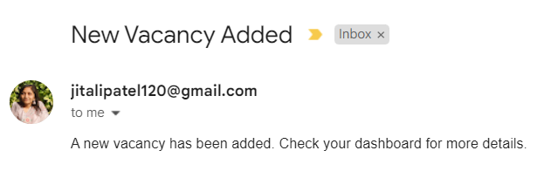
ADD VACANCY

Slide 41
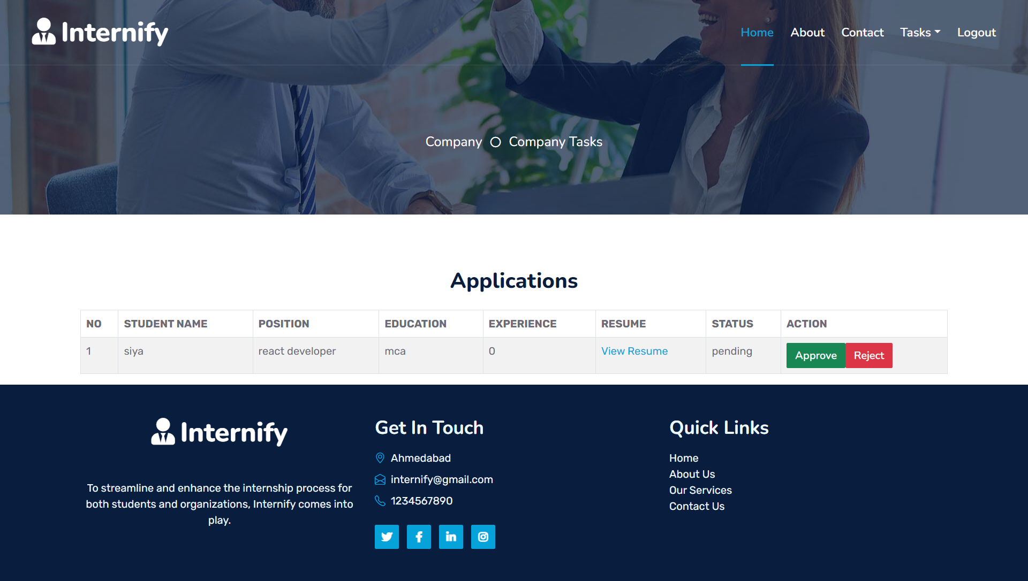
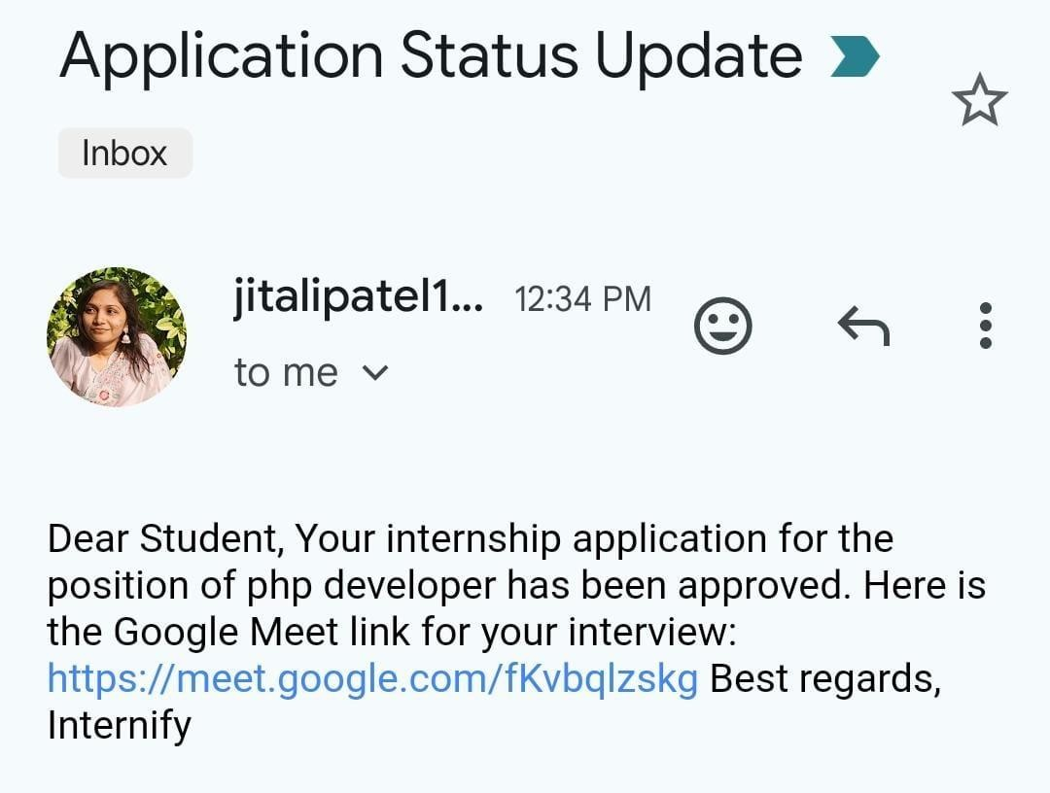
VIEW APPLICATIONS

Slide 42
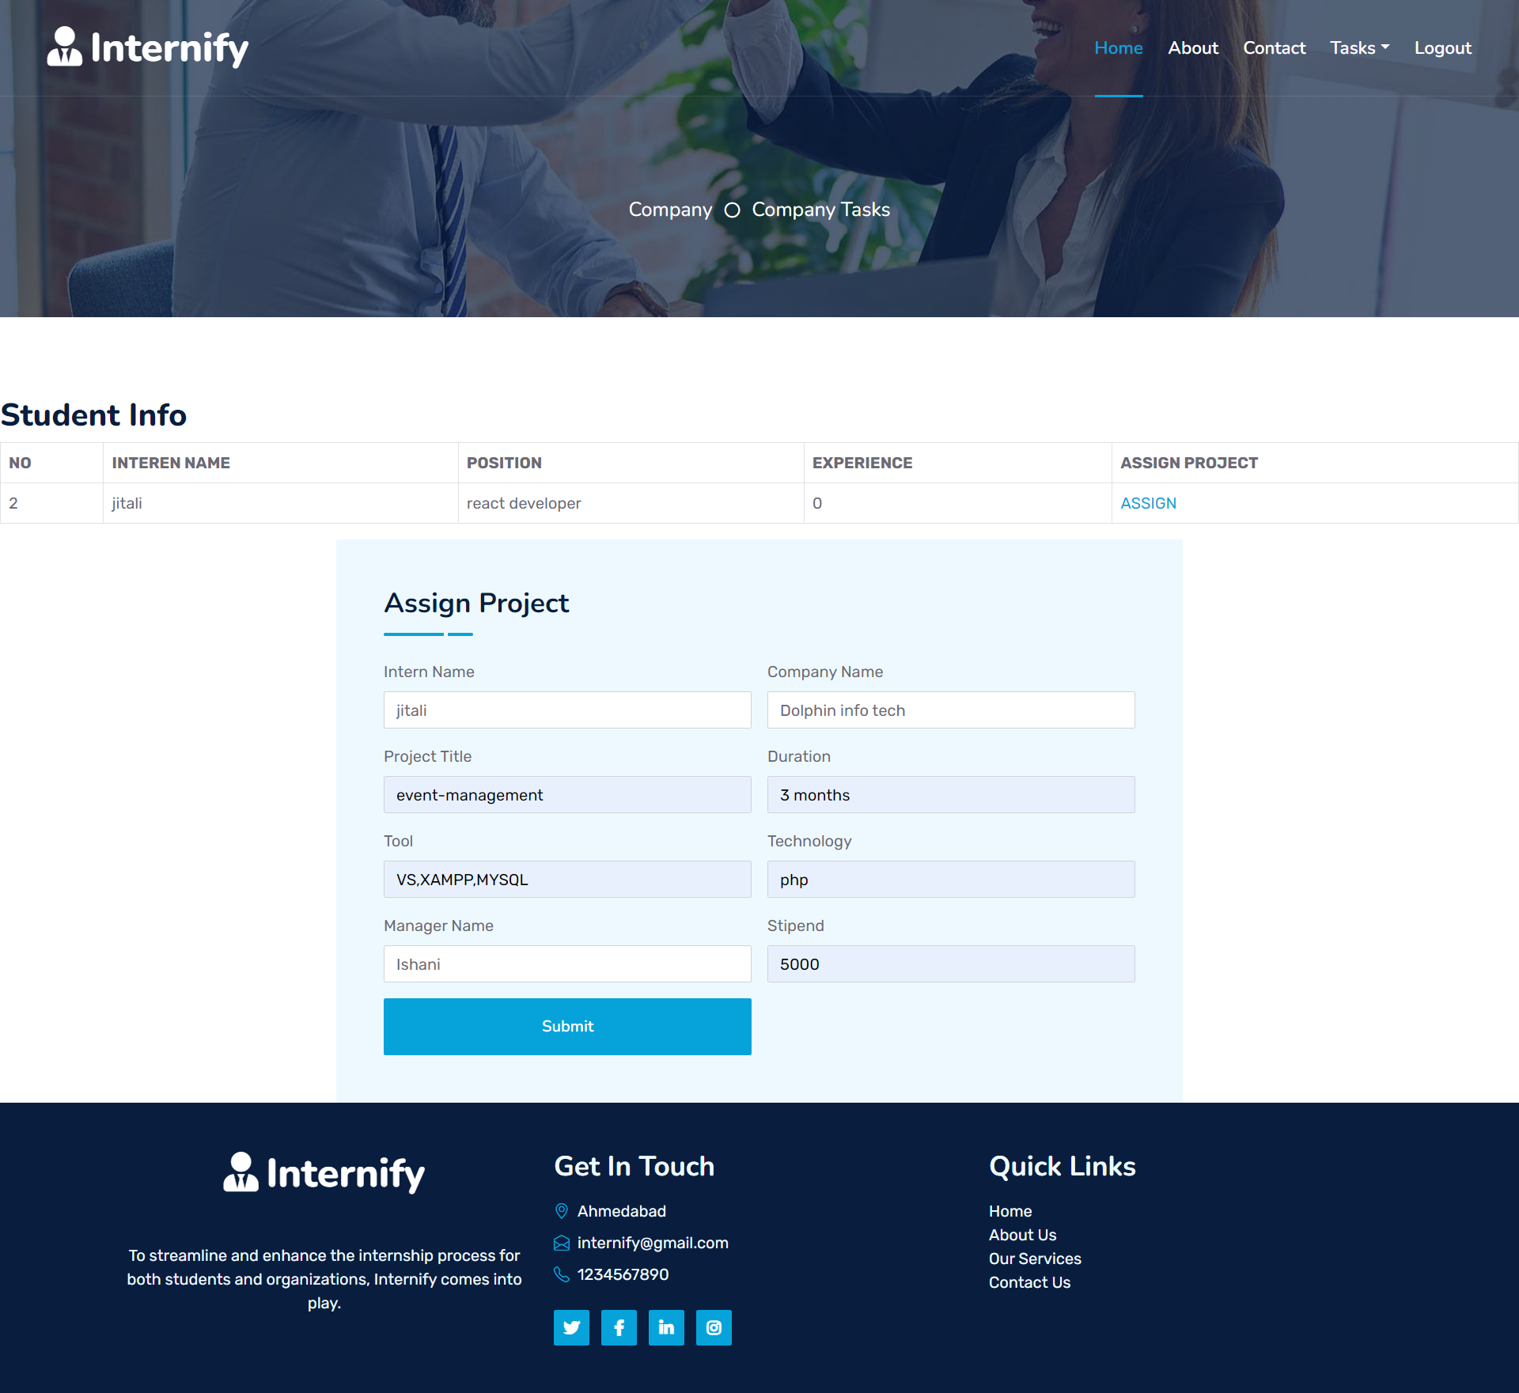
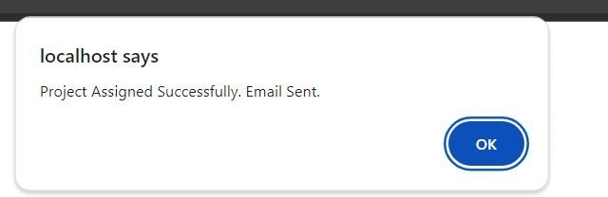
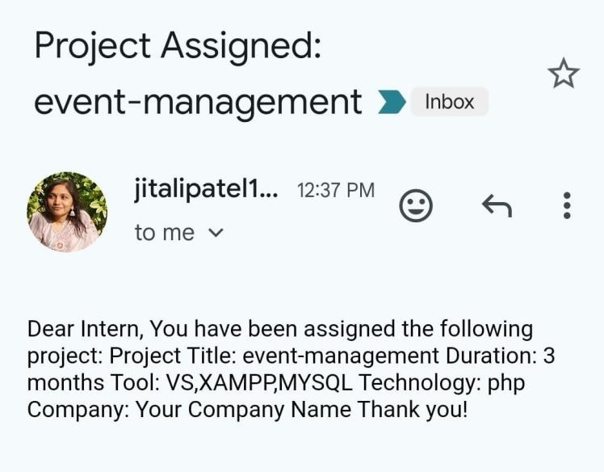
ASSIGN PROJECT

Slide 43
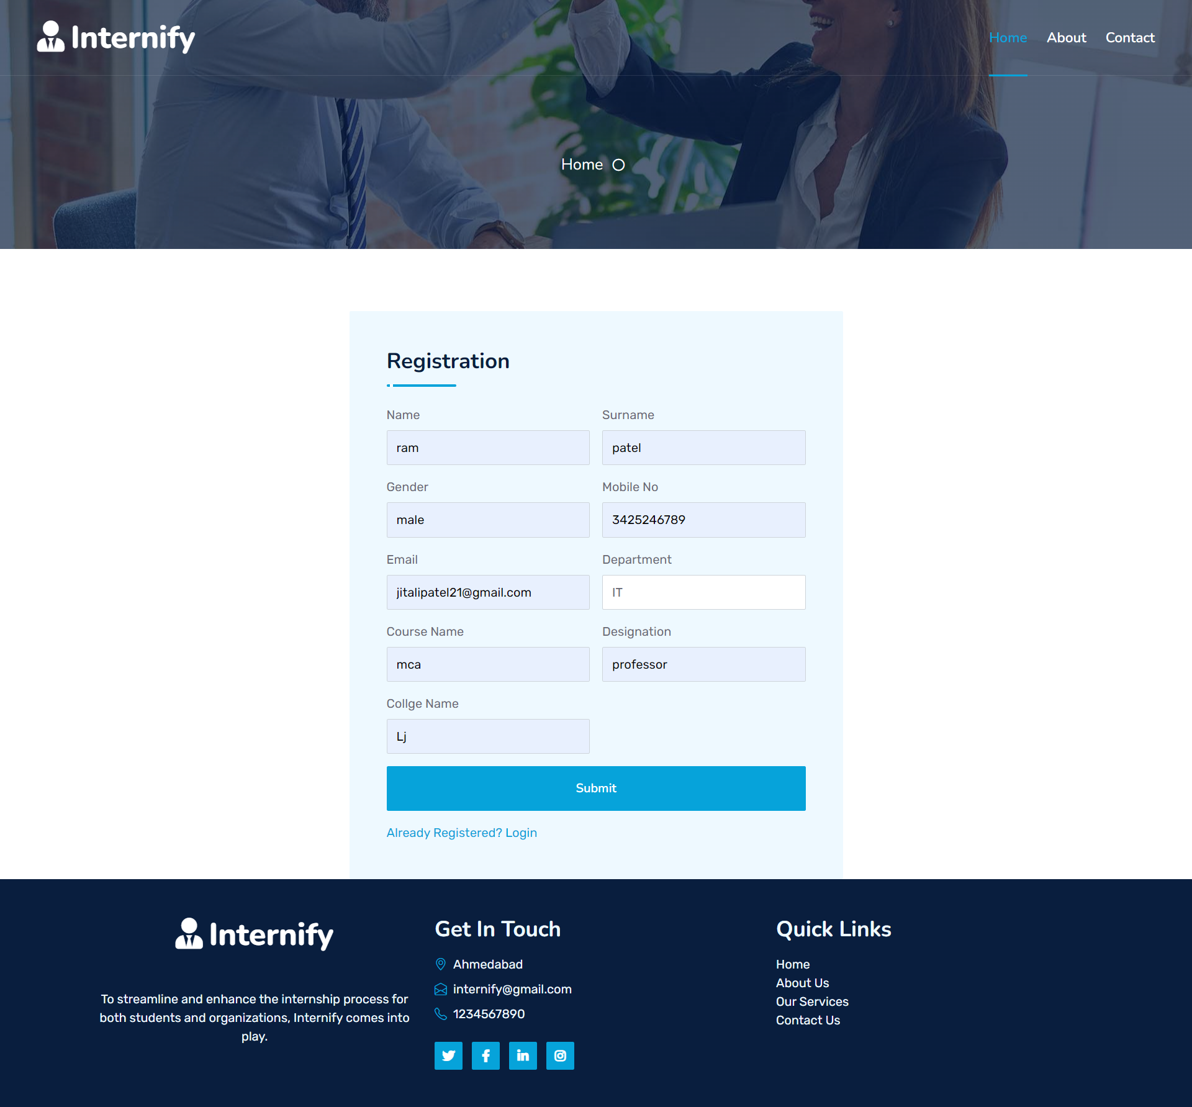
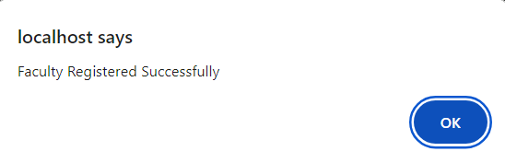
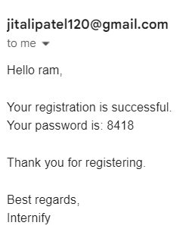
FACULTY REGISTRATION

Slide 44

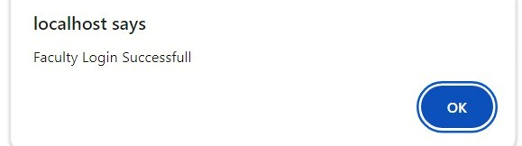
FACULTY LOGIN

Slide 45
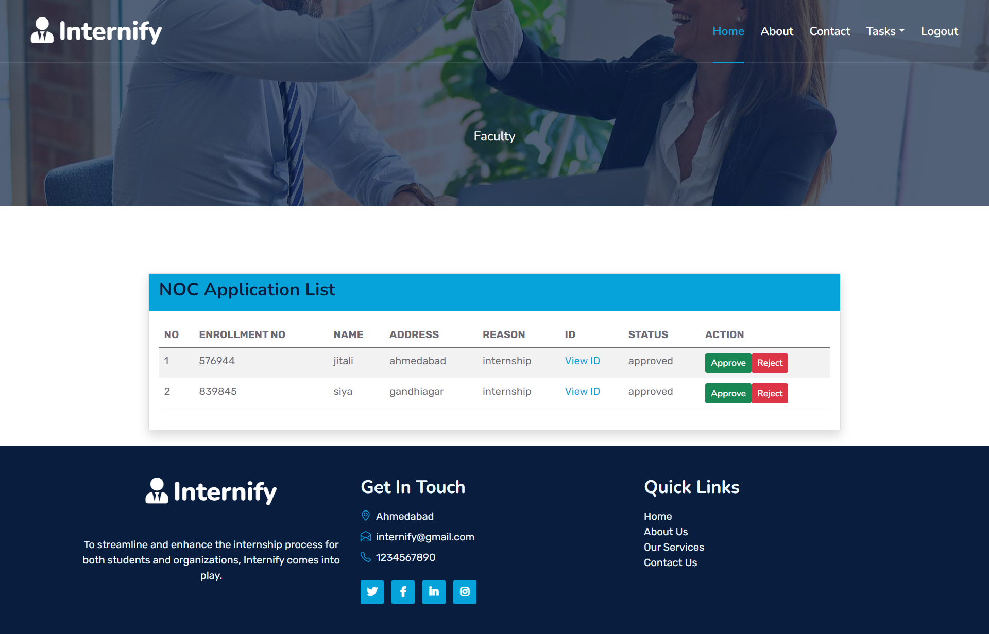
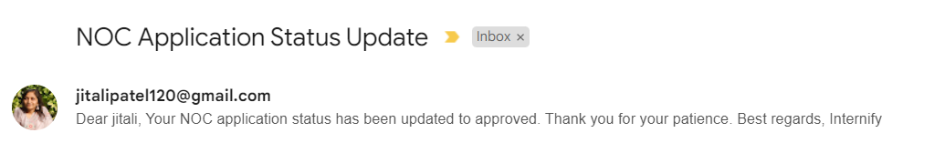
NOC APPLICATION

Slide 46
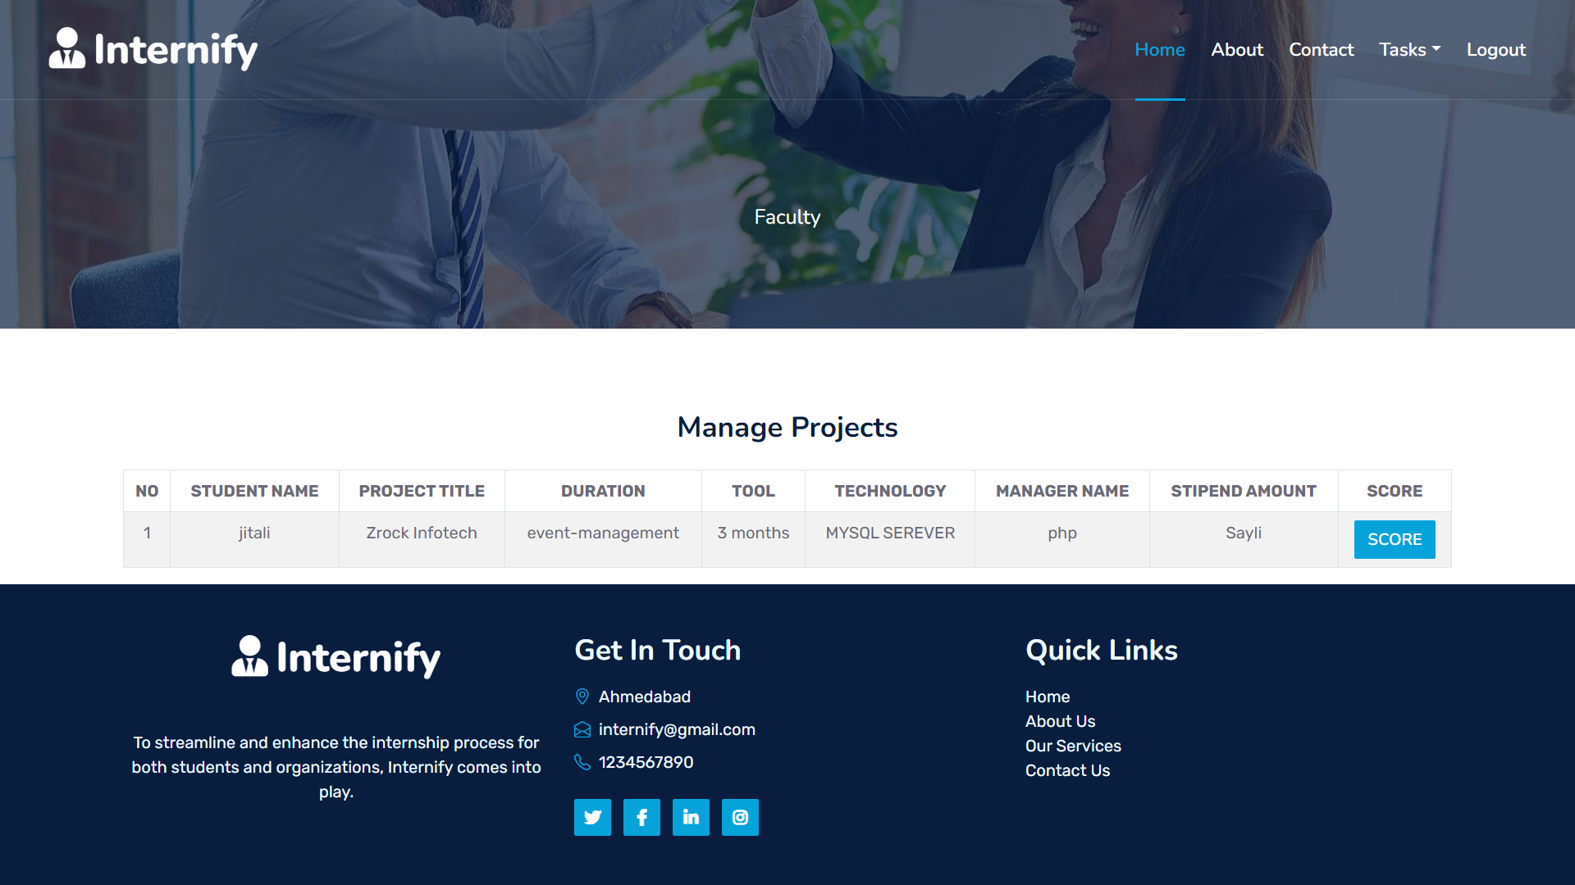
MANAGE PROJECT

Slide 47
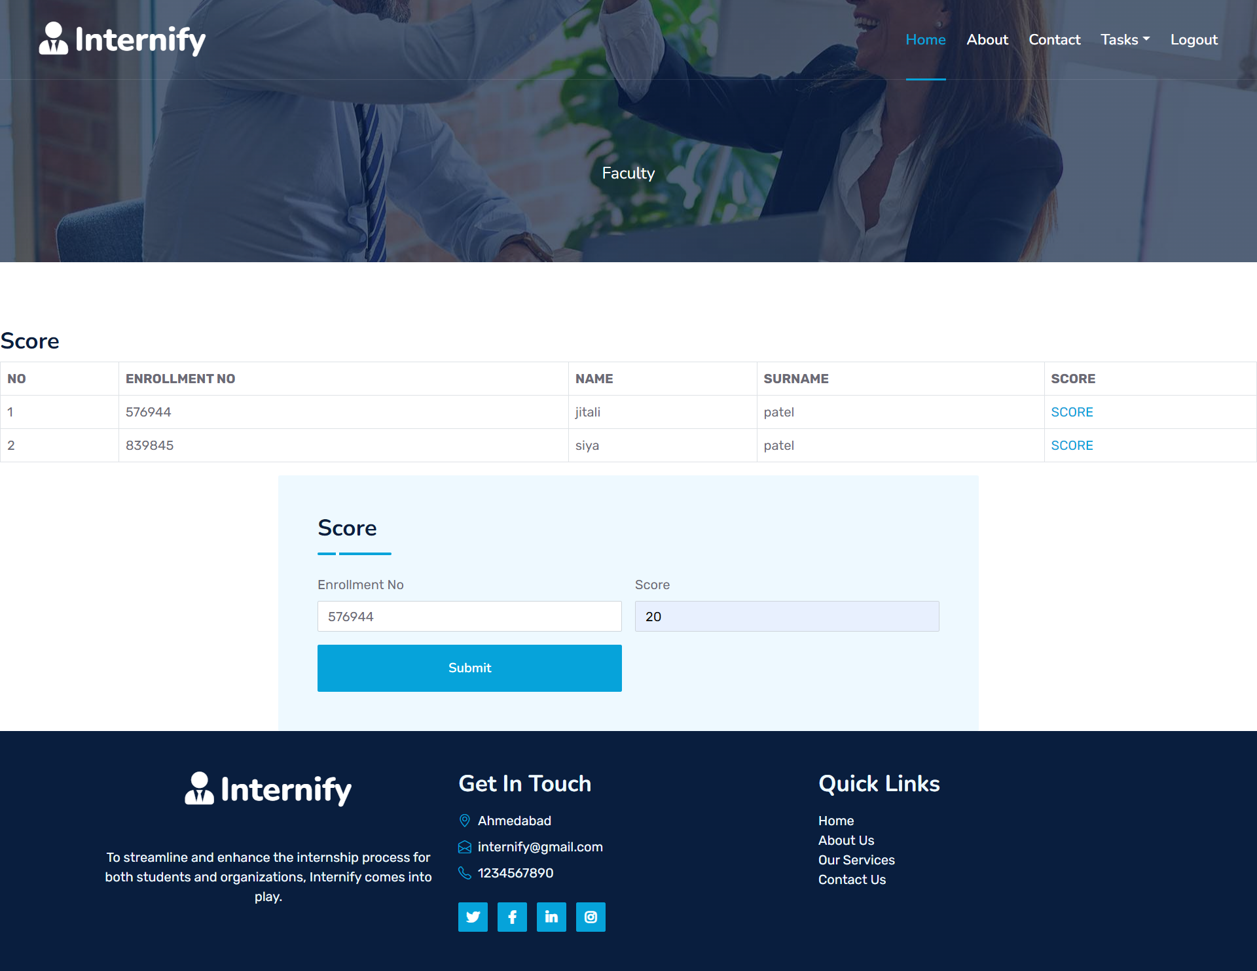
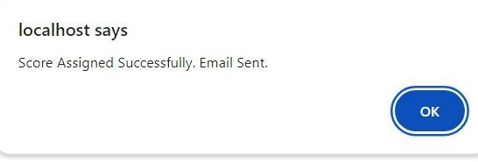
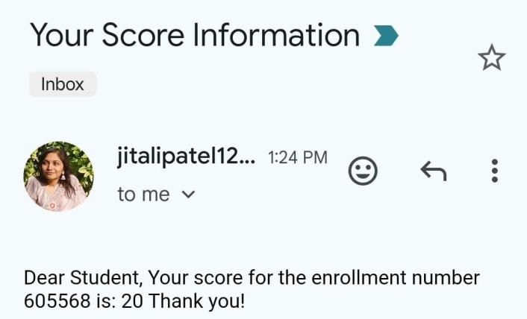
GIVING SCORE

Slide 48

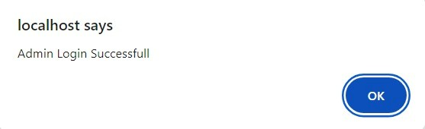
ADMIN LOGIN

Slide 49
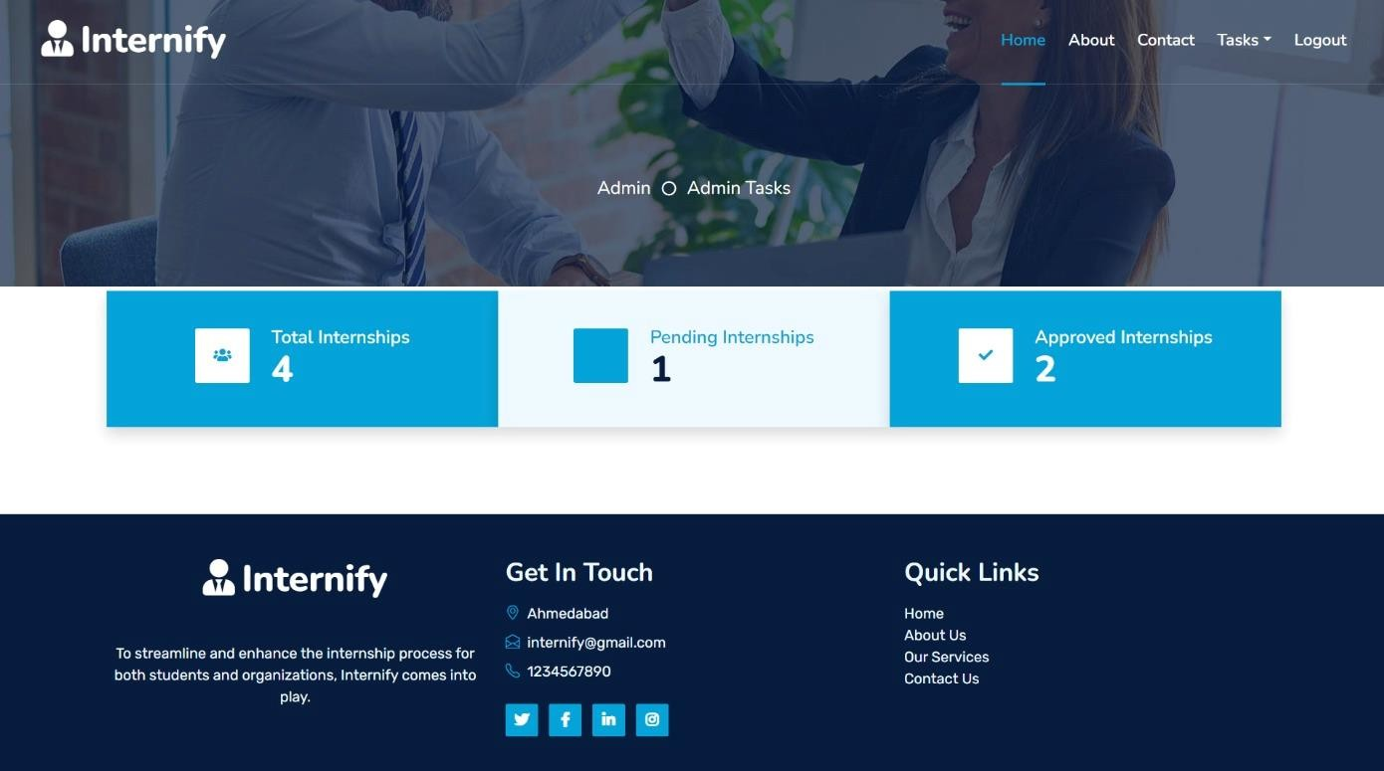
ADMIN DASHBOARD

Slide 50
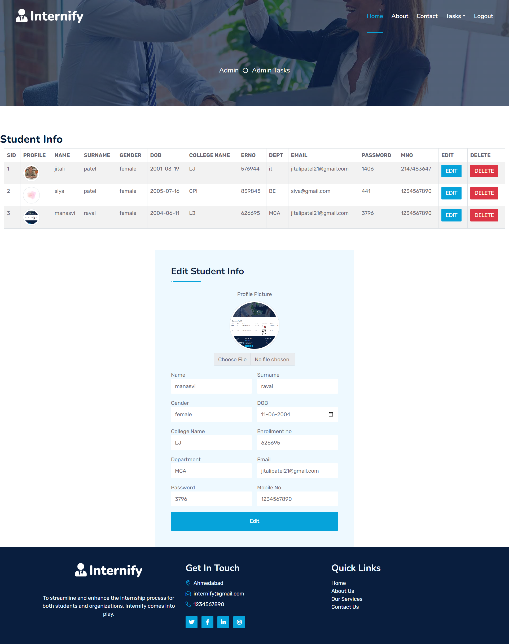
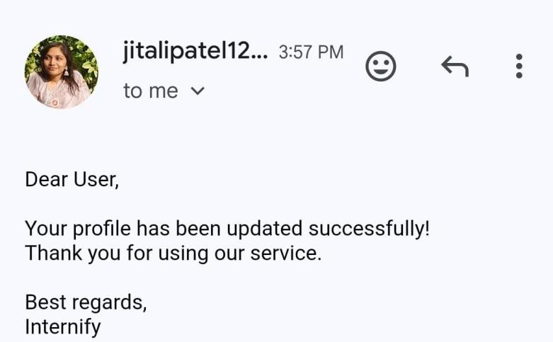
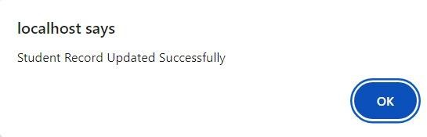
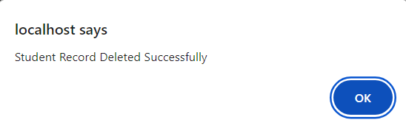
STUDENT INFO

Slide 51
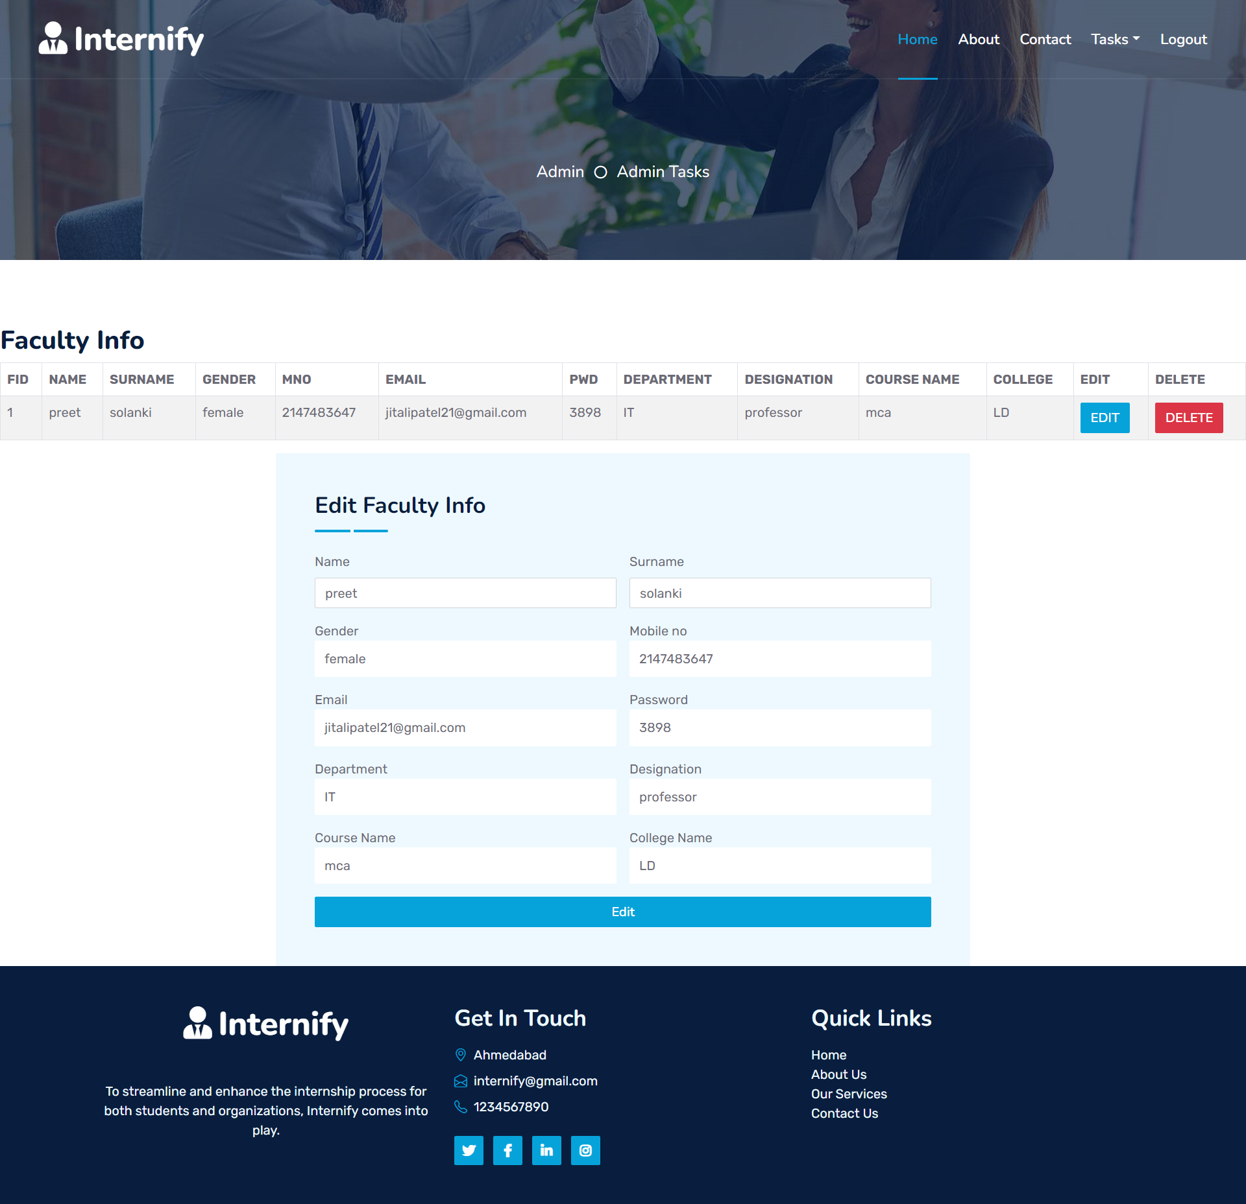
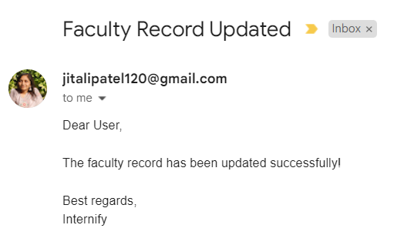
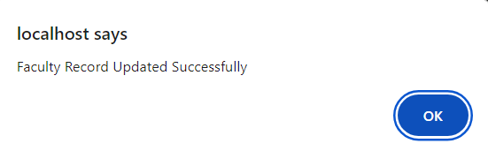
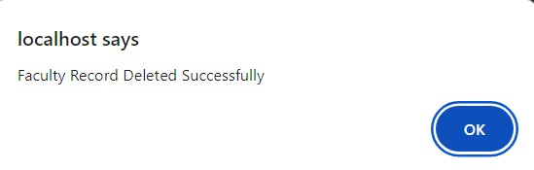
FACULTY INFO

Slide 52

REPORTS

Slide 53

STUDENT
REPORT

Slide 54

FACULTIES
REPORT

Slide 55

INTERNSHIP
REPORT

Slide 56

COMPNIES
REPORT

Slide 57

DOWNLOAD
REPORTS

Slide 58
CONCLUSION
Improved communication
Better resource allocation
Comprehensive reporting
Scalability and flexibility
User Friendly Interface for student, companies , admin and faculty

Slide 59
FUTURE ENHANCEMENT
Mobile app development
Virtual reality (VR) training modules
Accessibility features
We can add online aptitude test

Slide 60
THANK YOU

